Slide 1



Recommendation-Based
Digital Library System
Submitters:
Yuval Zohar
Amit Perets
Supervisor:
Dr Naomi Unkelos Shpigel
24-1-D-20
-1-

Slide 2

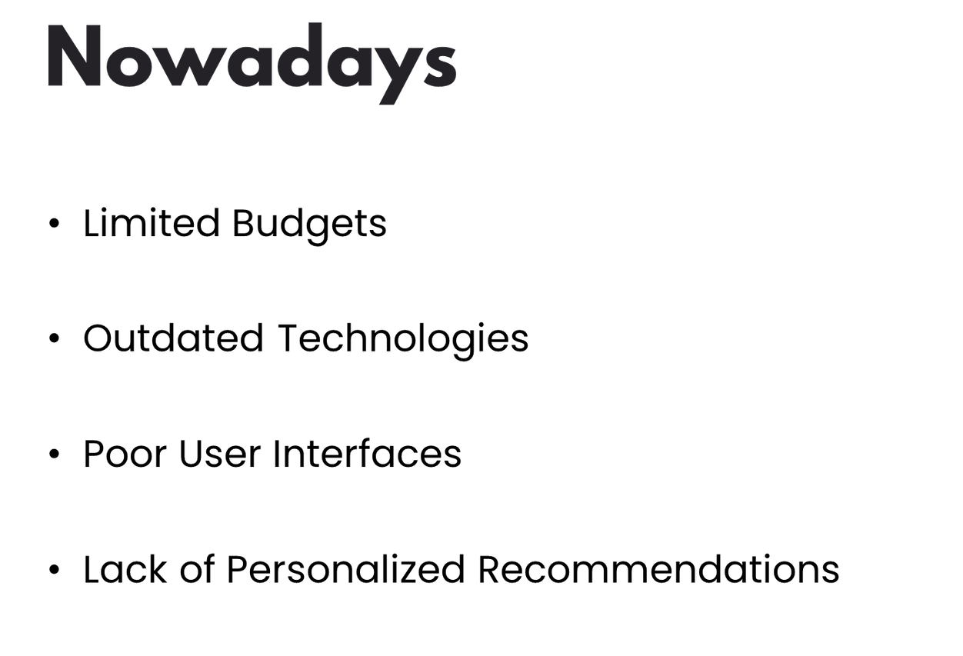
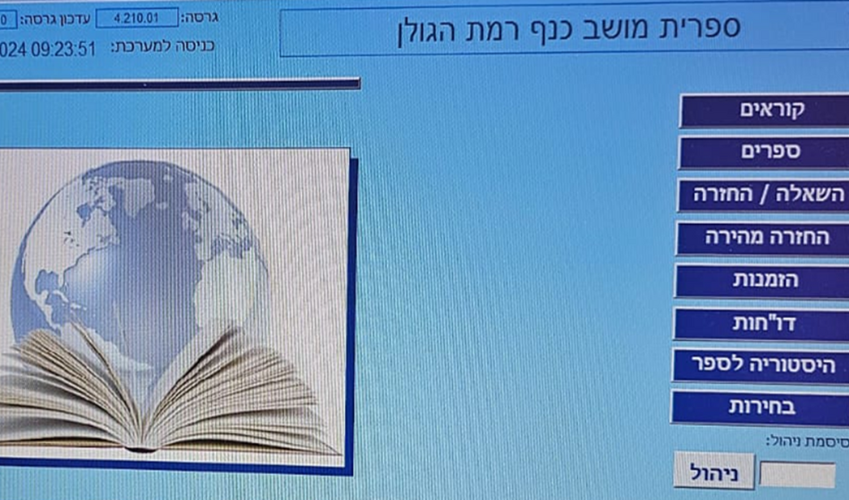
Moshav Kanaf Library (2011)– Microsoft Access based
-2-

Slide 3
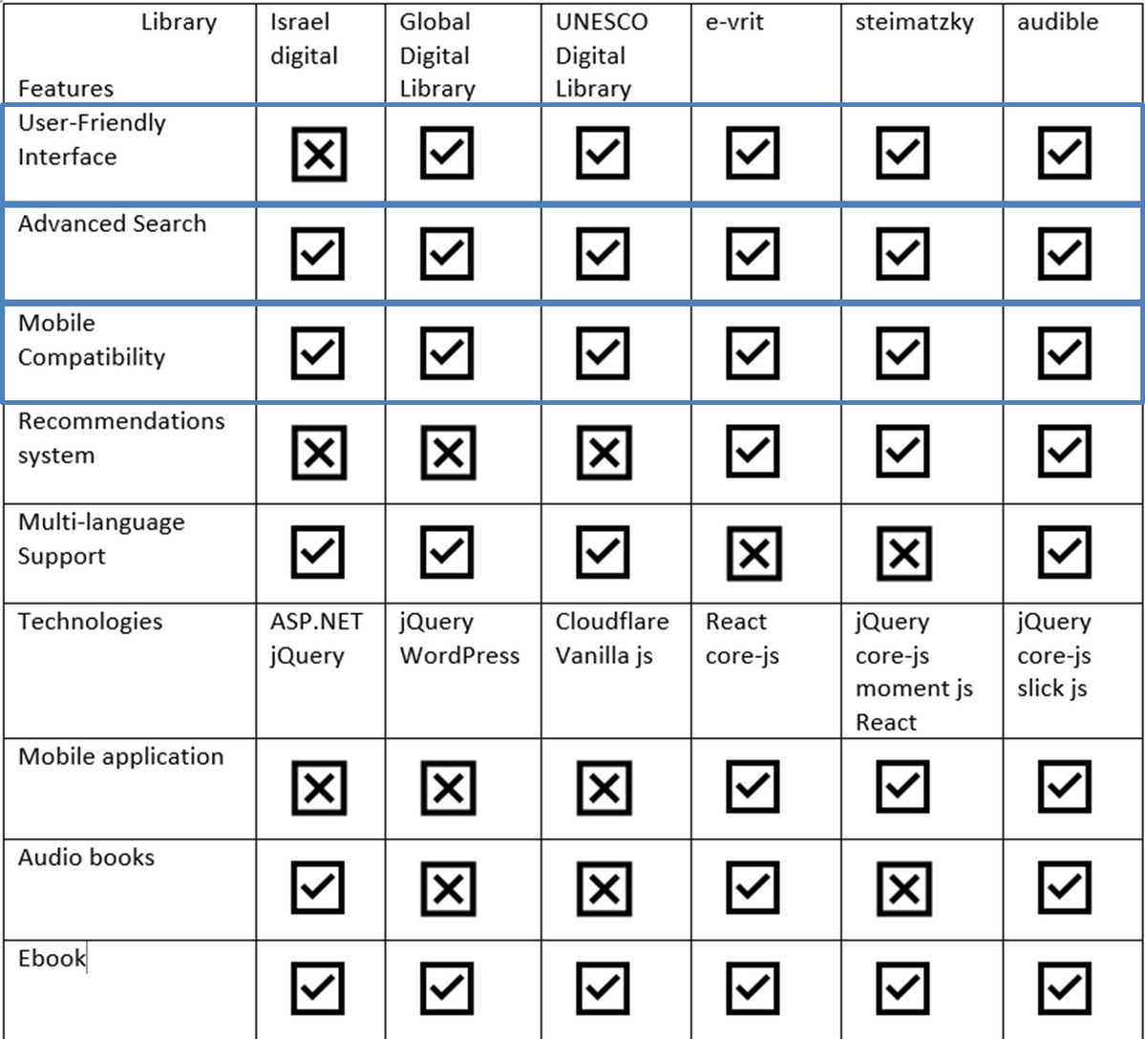
Current Library Websites
Comparison between 6 digital library systems across a variety of features and elements within them
-3-

Slide 4
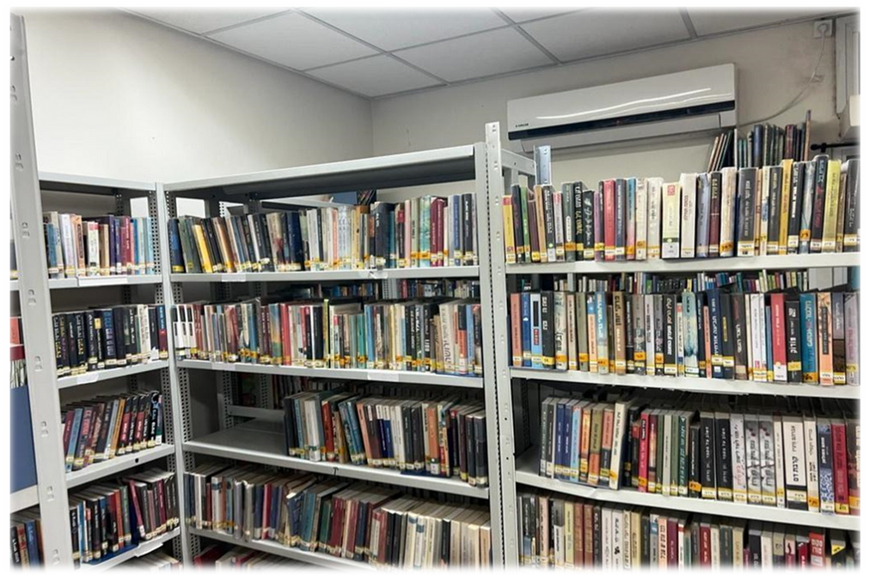
Requirements gathering
Interview with the library staff of Moshav Kanaf:
Shahar – Library manager
Dafi - Librarian
Reviewed the current system and its limitations
Gathered requirements for the intended system
Received guidelines to support the development process
-4-

Slide 5


Survey for readers communities & potential readers
What additional features would you like to see in our system?
Do you prefer using our system on a phone or a PC?
Would you be interested in borrowing digital books through our system?
Are there any websites with features you particularly like? If so, which features and why?
Do you have any suggestions for enhancing the user experience on our platform?
-5-

Slide 6
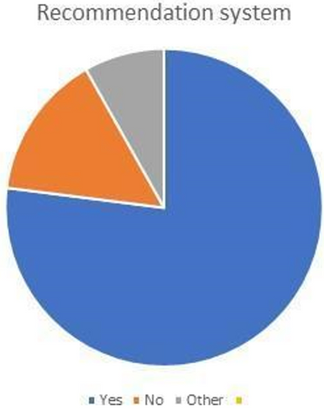
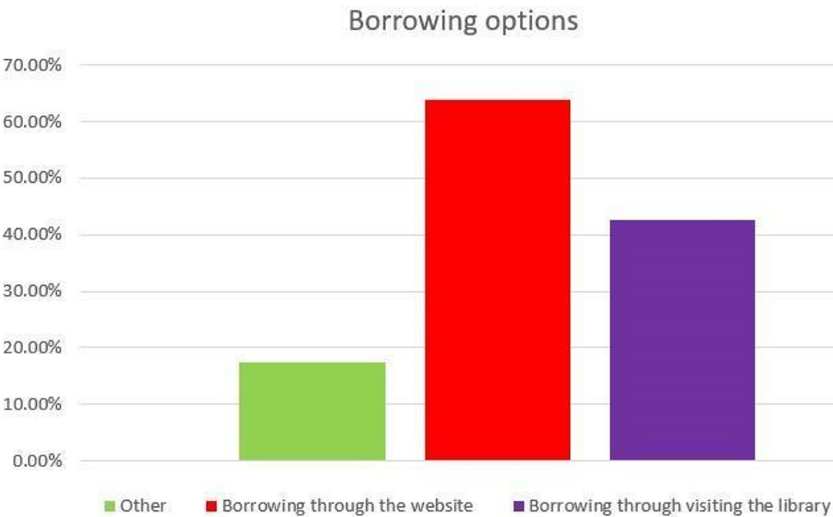
Questionnaire results
61 responses
Recommendations
Waiting lists
Borrowing through website
Notifications
Late book return
-6-

Slide 7
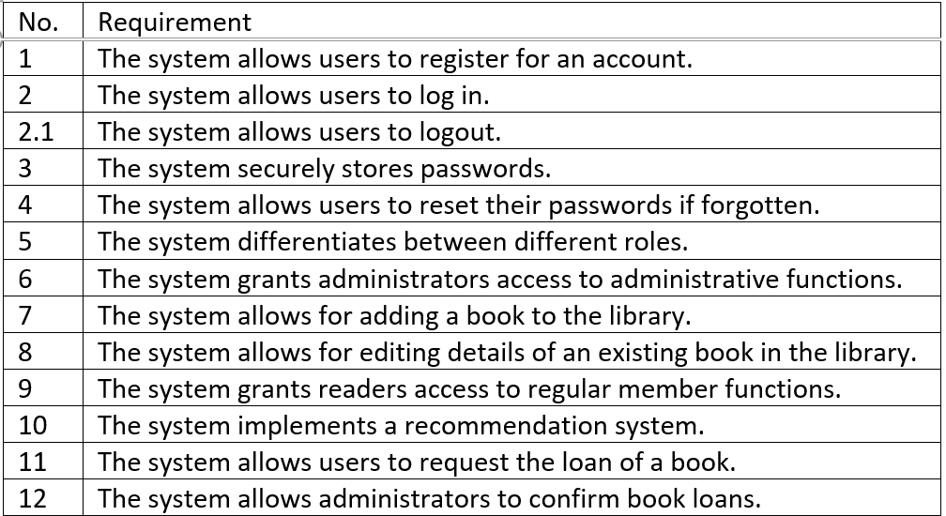
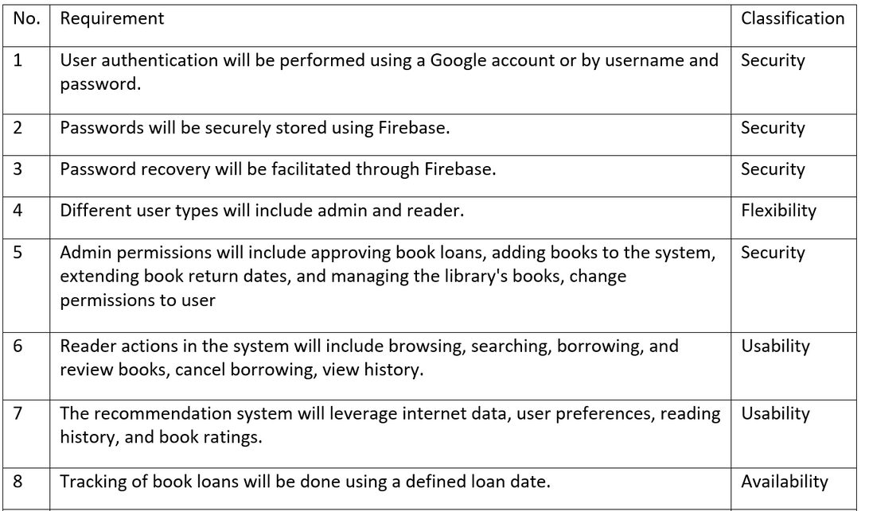
Requirements drawn from the interviews
Functional requirements
Non - Functional requirements
-7-

Slide 8
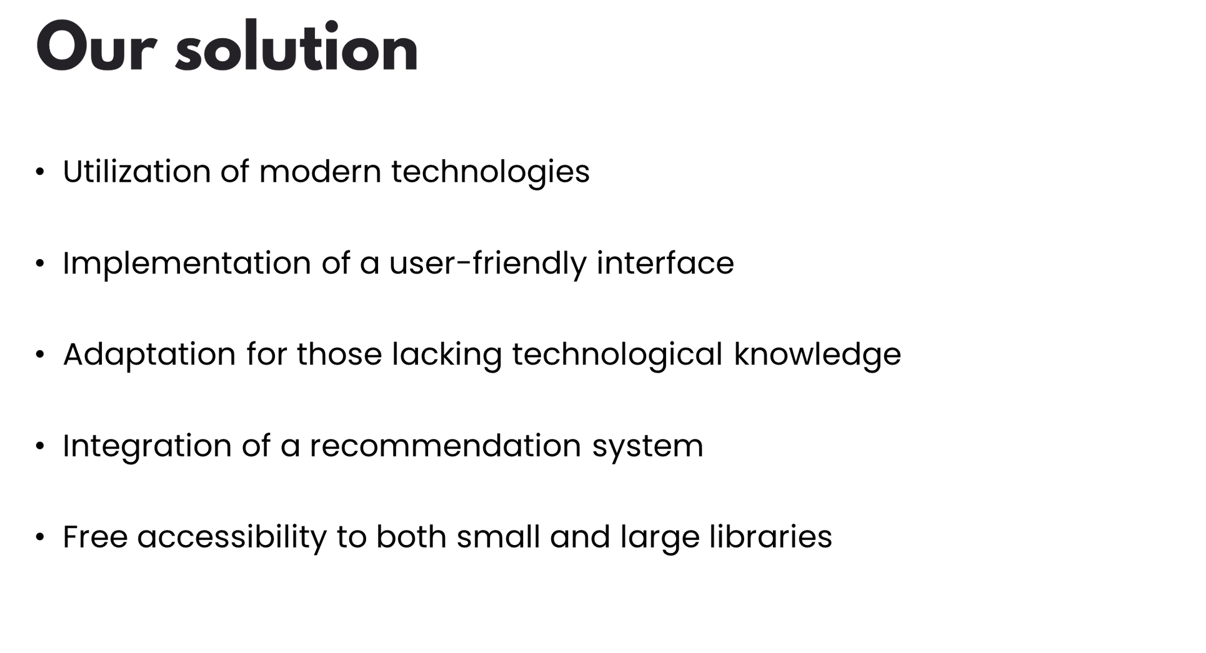

-8-

Slide 9

Challenges
Tracking books copies
Lack of large Hebrew book API or dataset
Web-scraping
Gather information from outdated and disorganized files containing data about the library
-9-

Slide 10
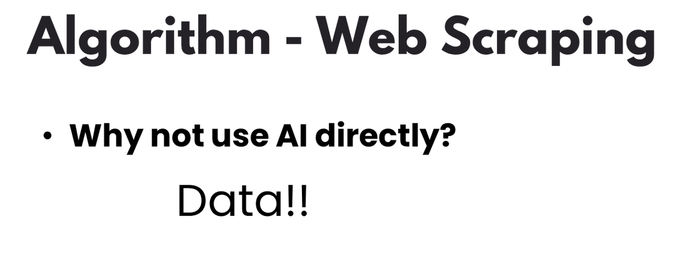
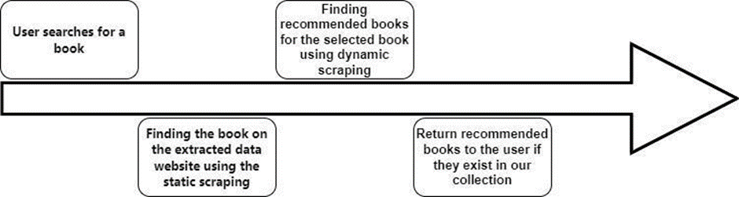
-10-

Slide 11

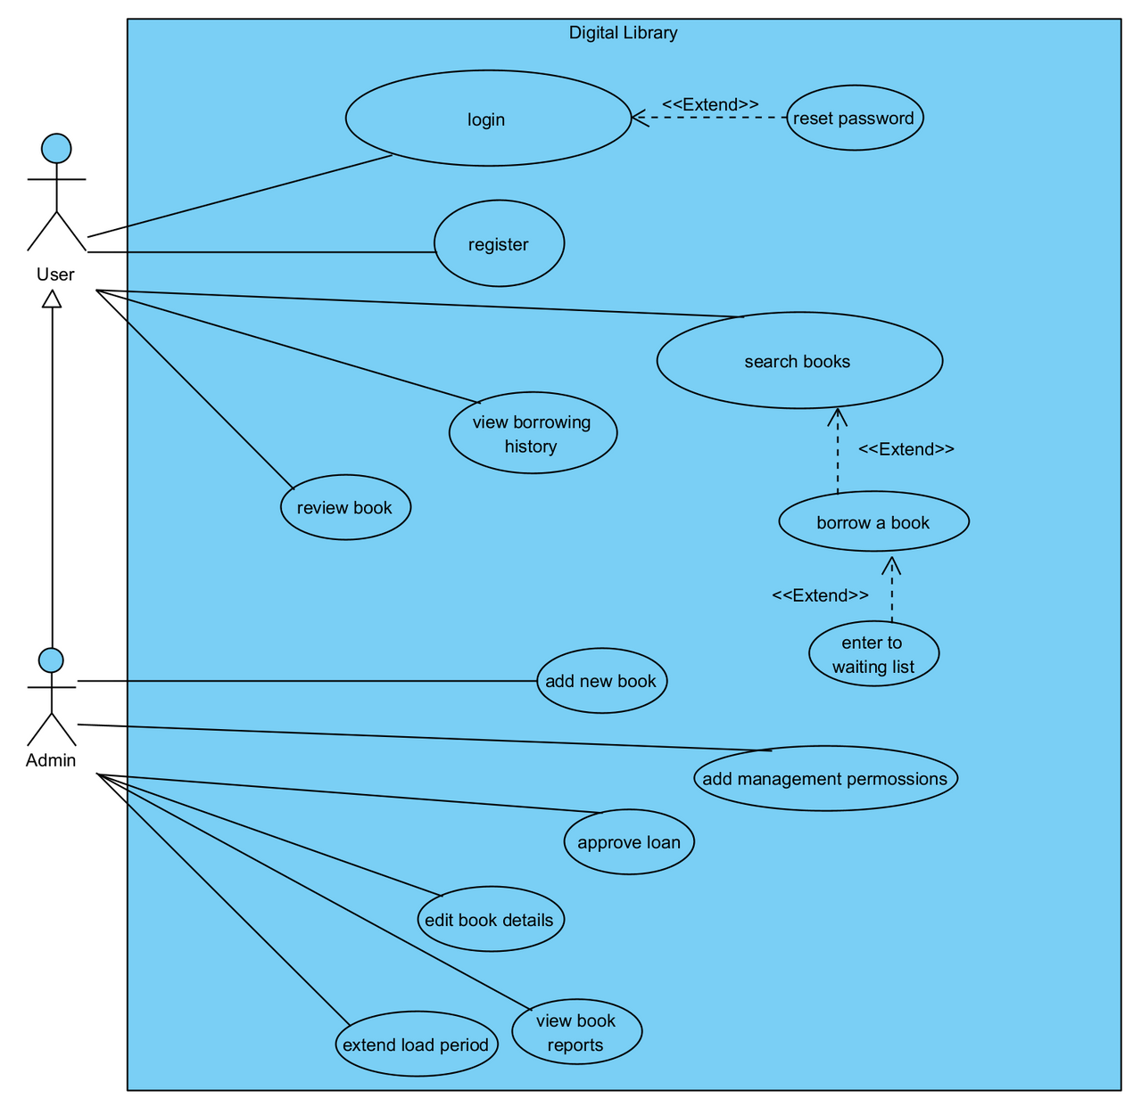
-11-

Slide 12

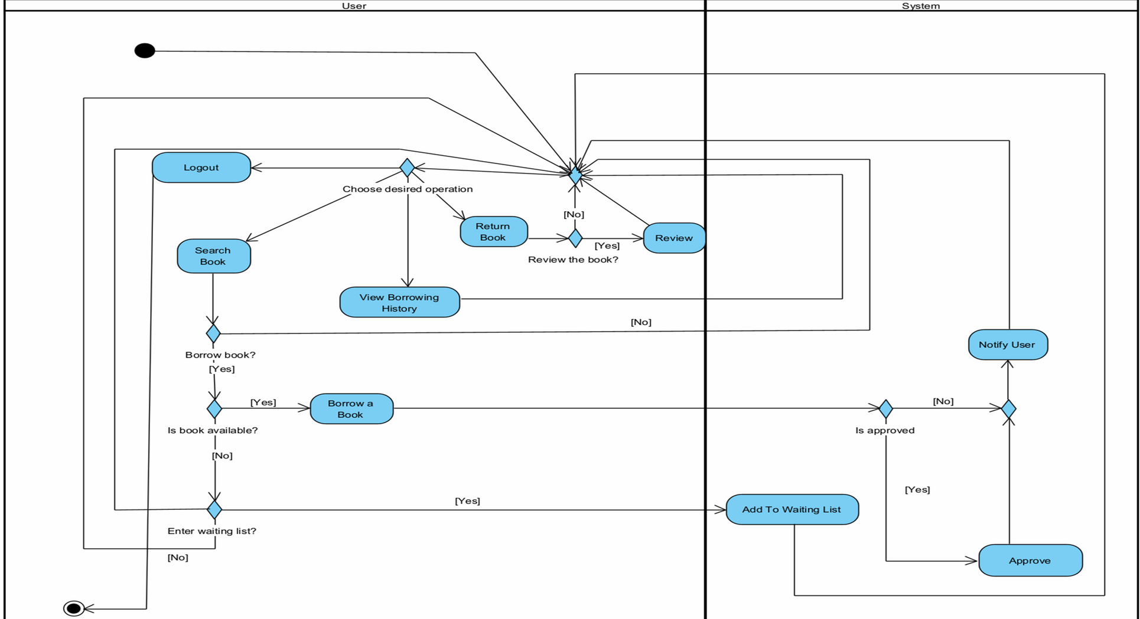
-12-

Slide 13

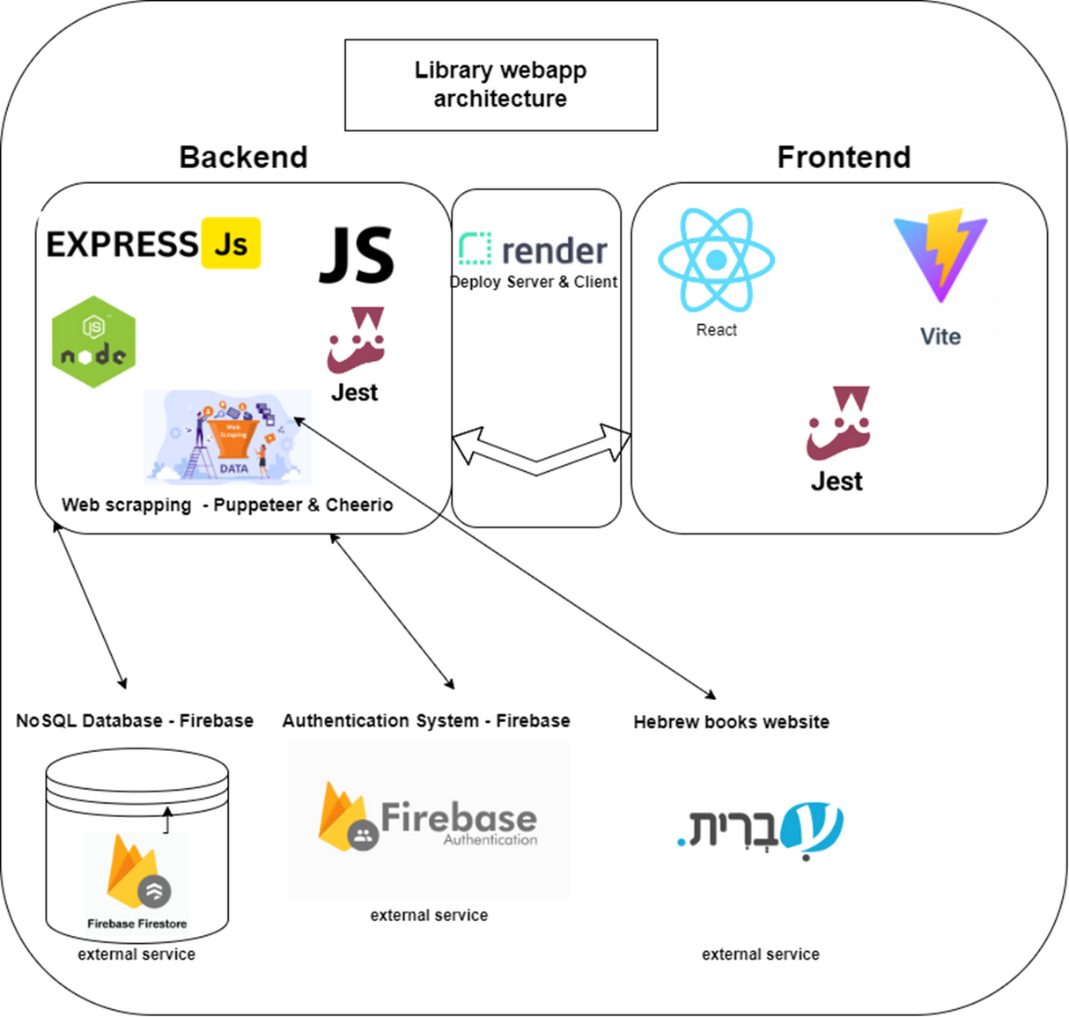
-13-

Slide 14
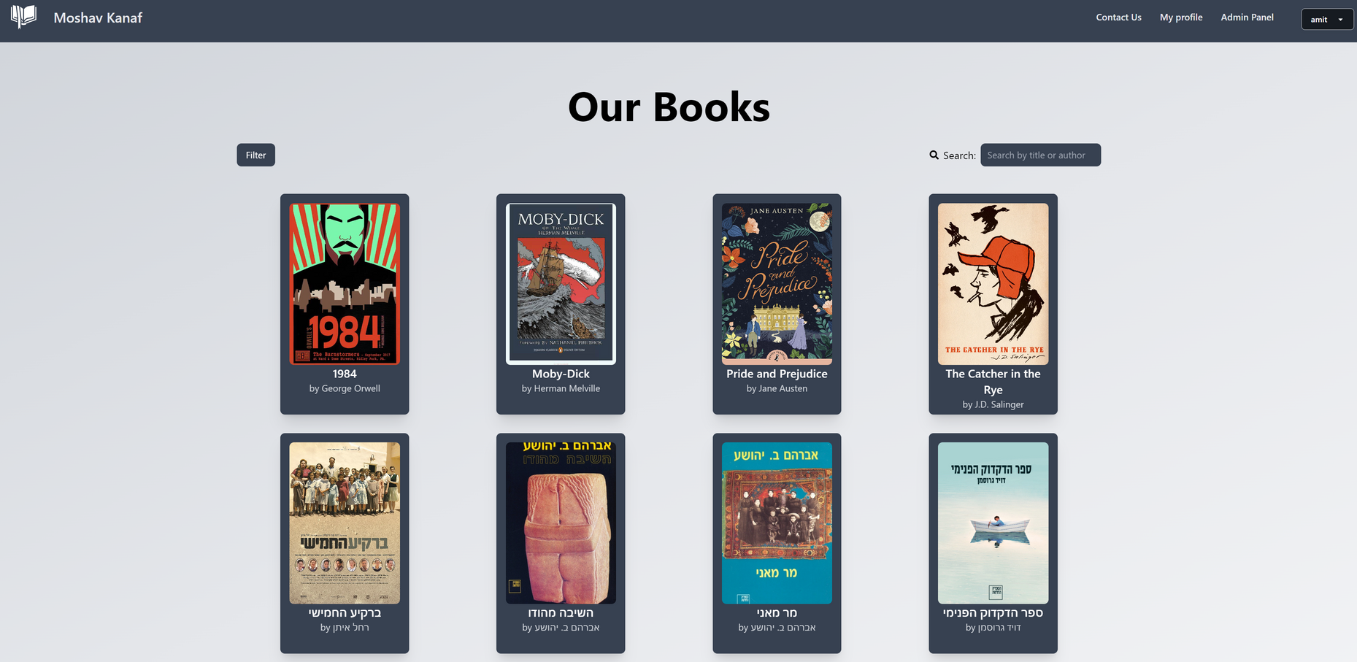
Prototype
Search books page
-14-

Slide 15
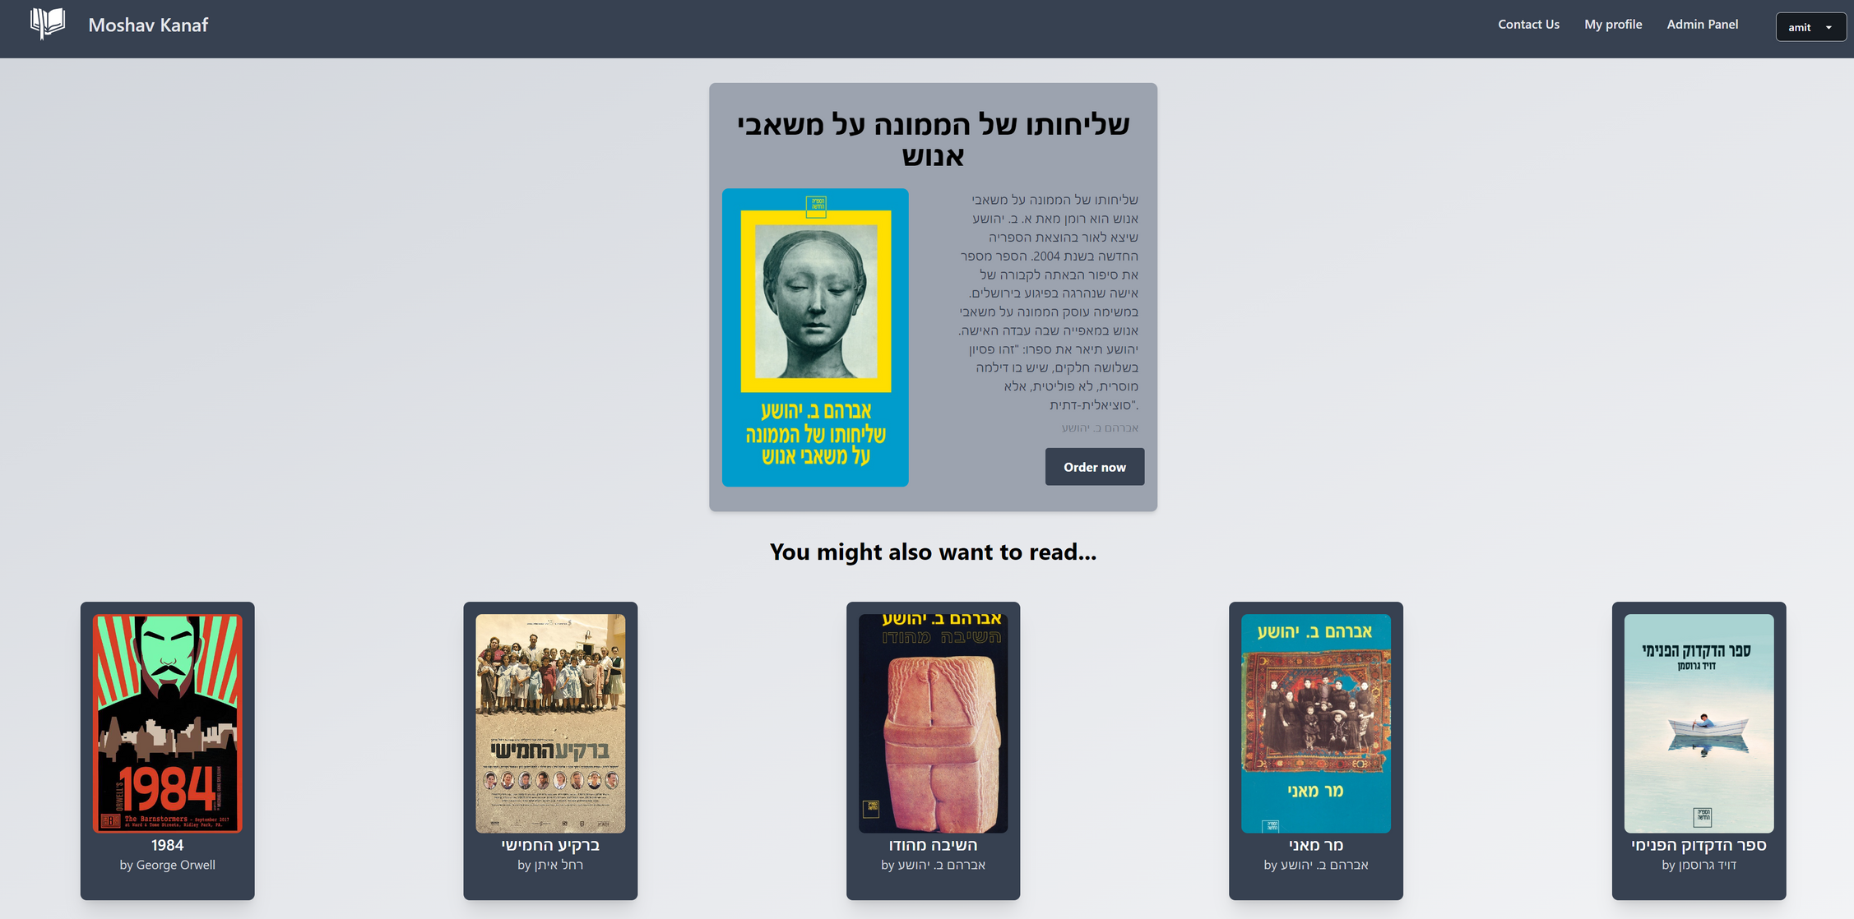
Order a book page
-15-

Slide 16
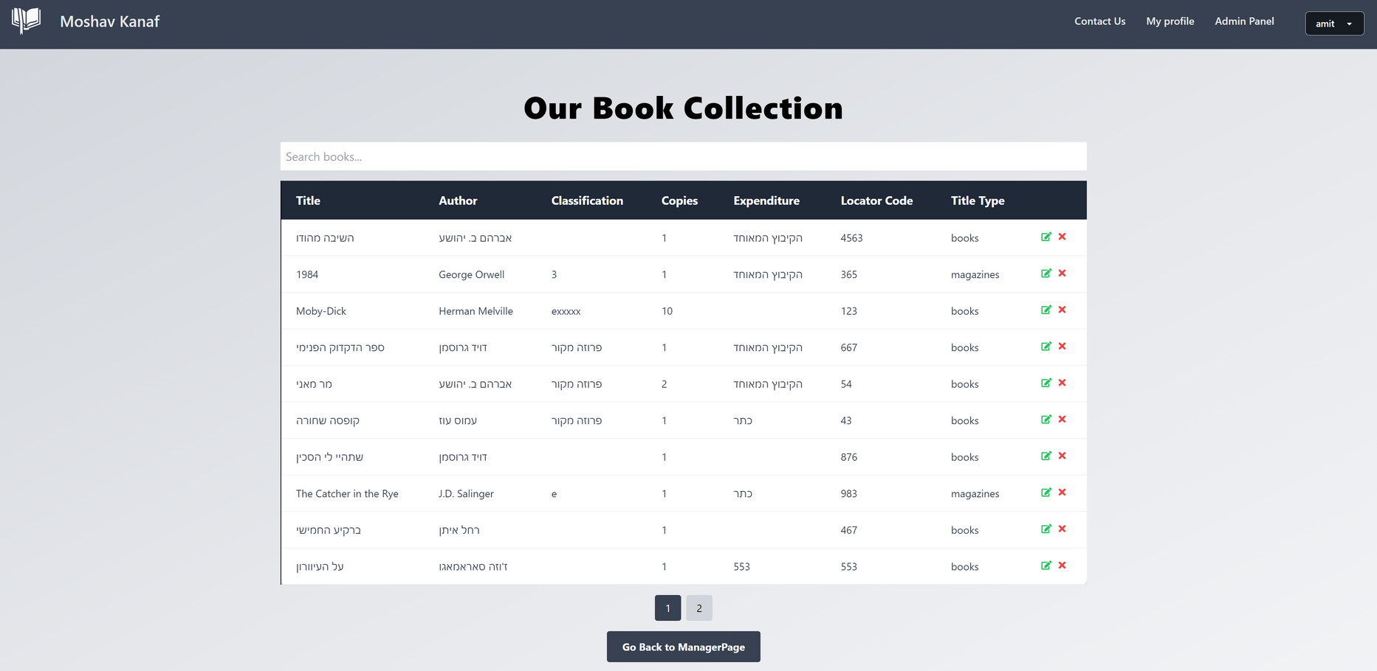
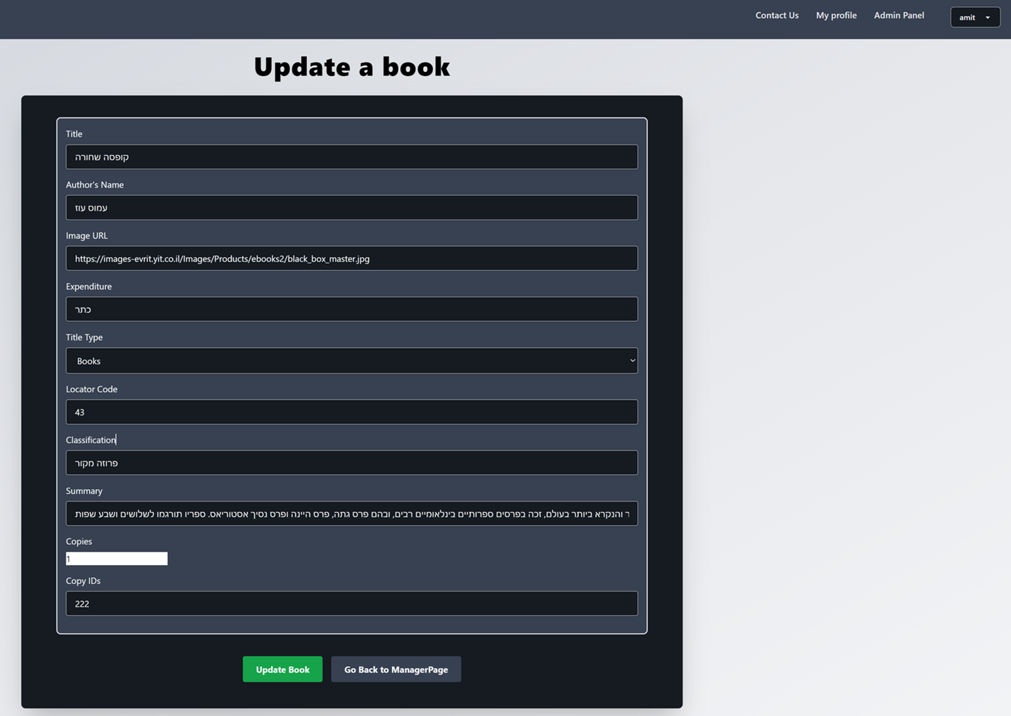
Admin panel pages
-16-

Slide 17
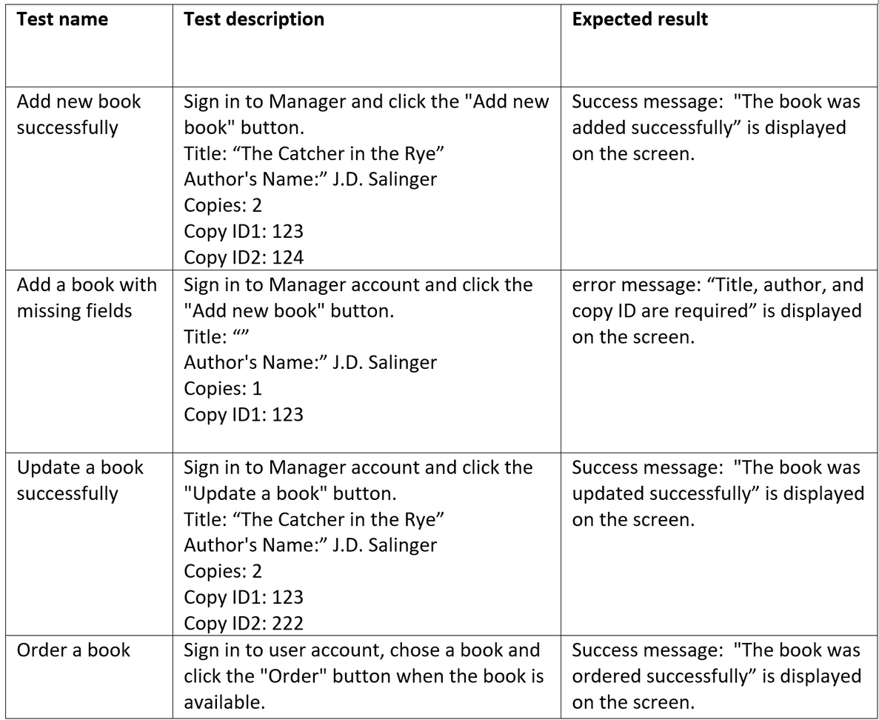
Tests
Login tests
Ordering books tests
Editing books tests
-17-

Slide 18



-18-

